Slide 1
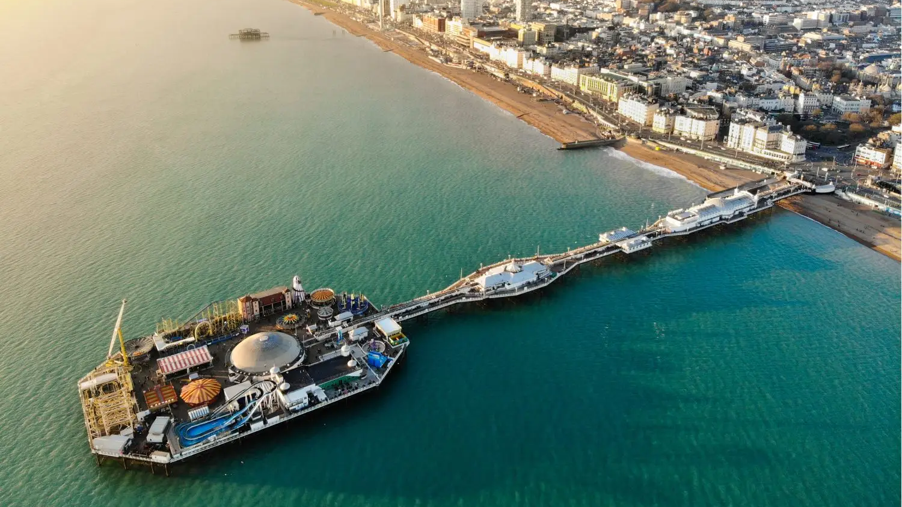
Brighton Student Bike Rental: Launch Plan
Using RCYL bikes made from recycled plastics

Slide 2
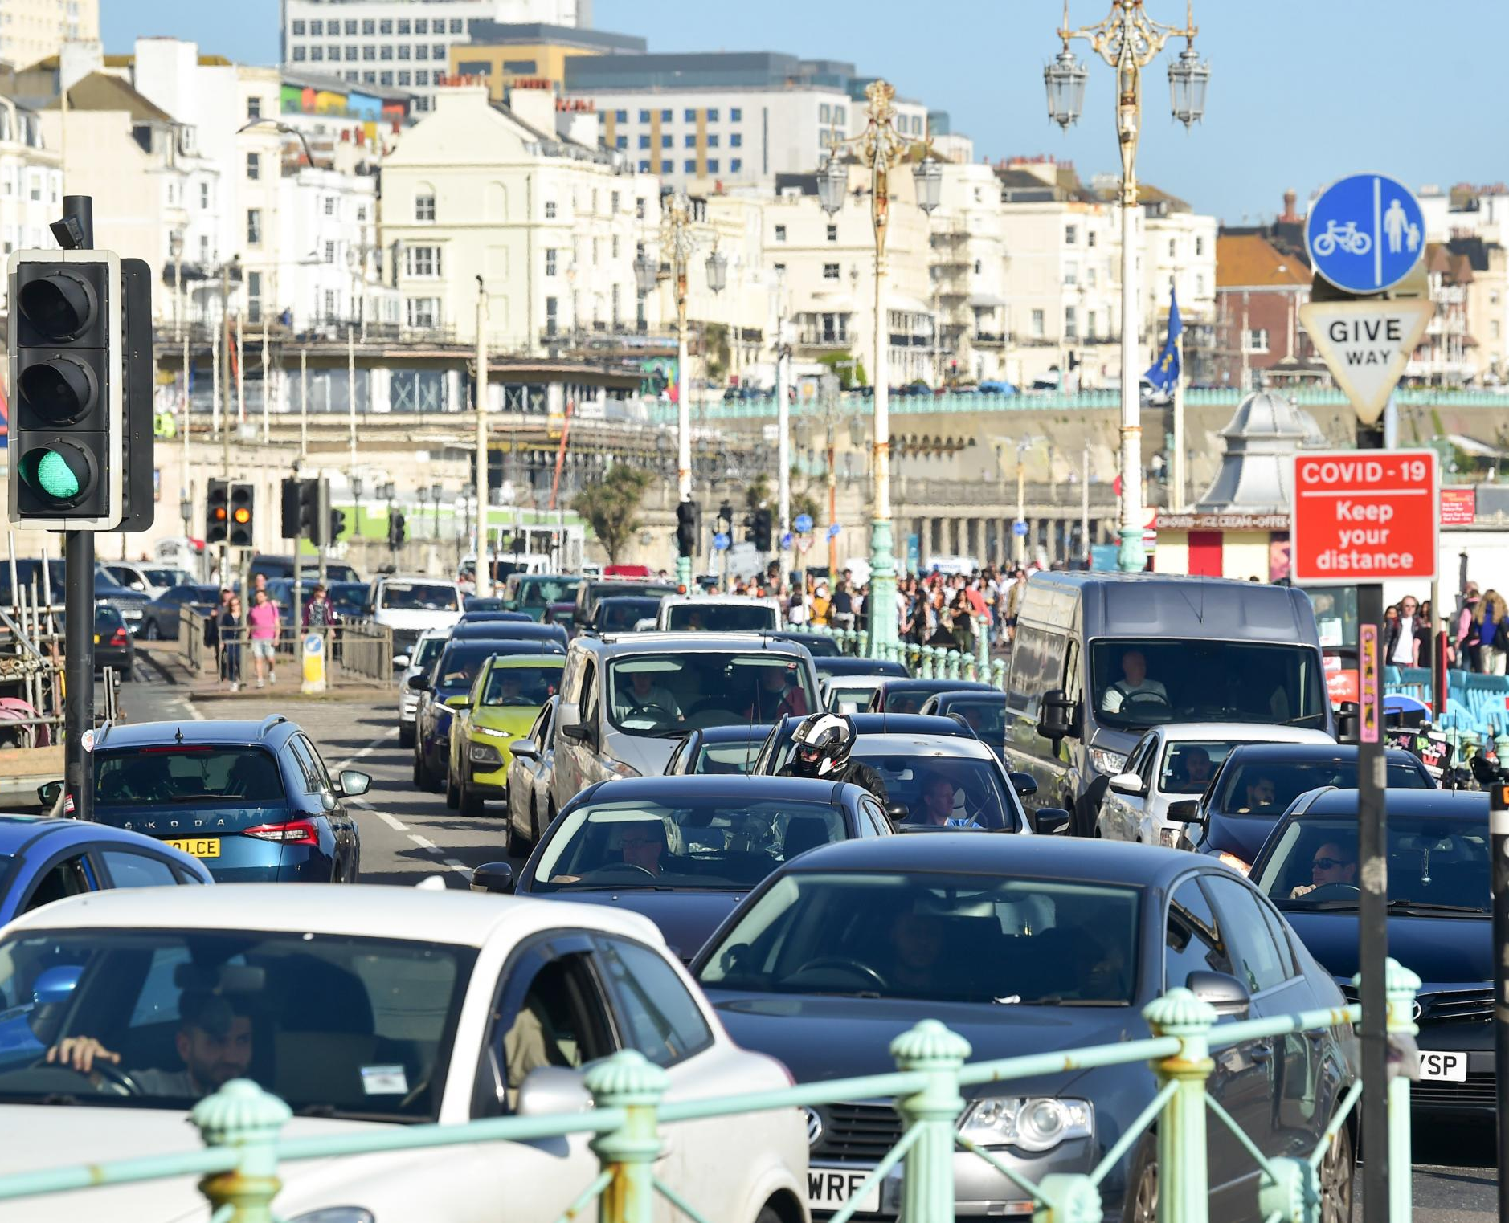

Problem Context
Plastic Waste Crisis: 450m tonnes produced yearly; <10% recycled.
Urban Transport Issues: congestion, pollution, costly student travel.

Slide 3
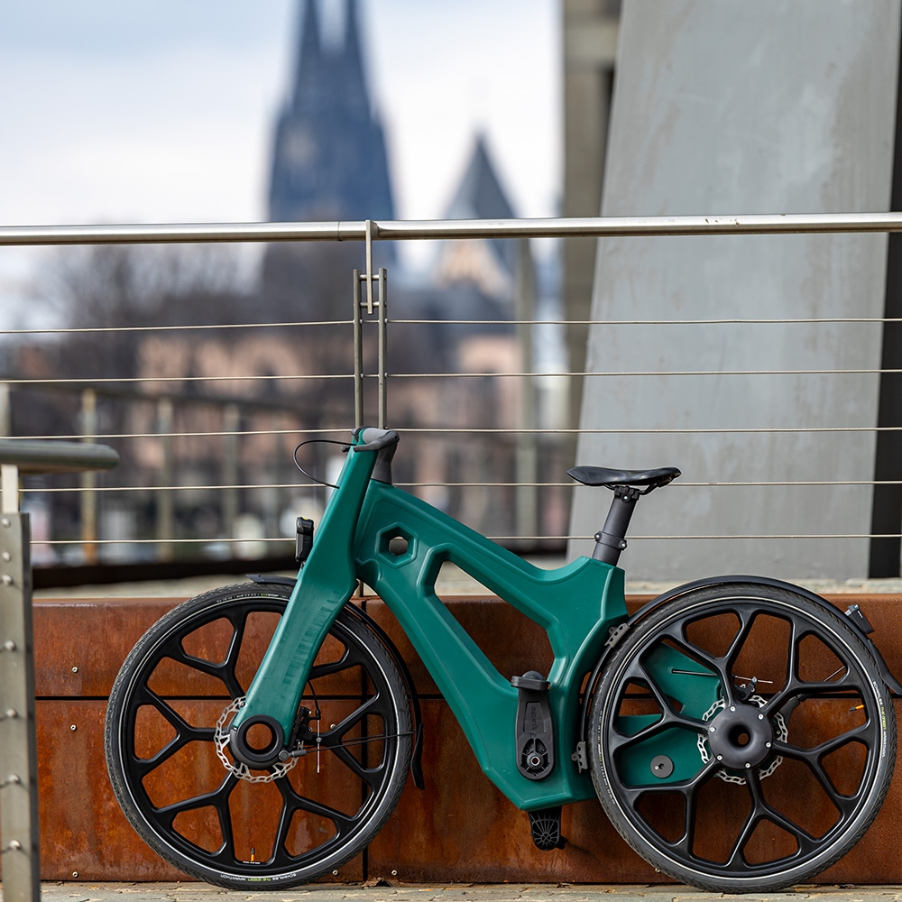
The Solution
Student-first bike rental service using recycled plastic bikes.
Affordable, sustainable, reliable.
Anchored in Circular Economy & SDGs (11 & 13).

Slide 4
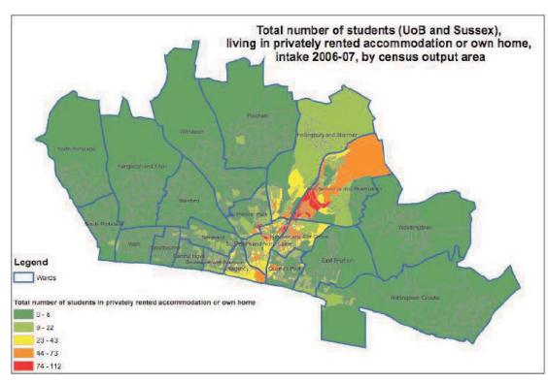
Why Brighton?
37,700 students across two universities.
Strong cycling culture + council climate goals.
Lewes Road = main student corridor.

Slide 5
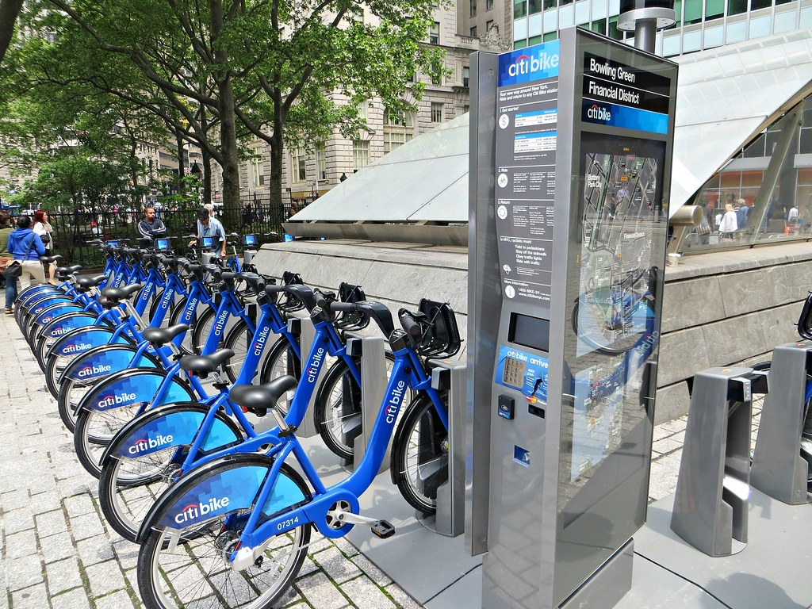
Service Model
Docked system (recommended): reduces clutter, aligns with council, reliable.
24/7 operation, with possible “quiet hours” policy.

Slide 6
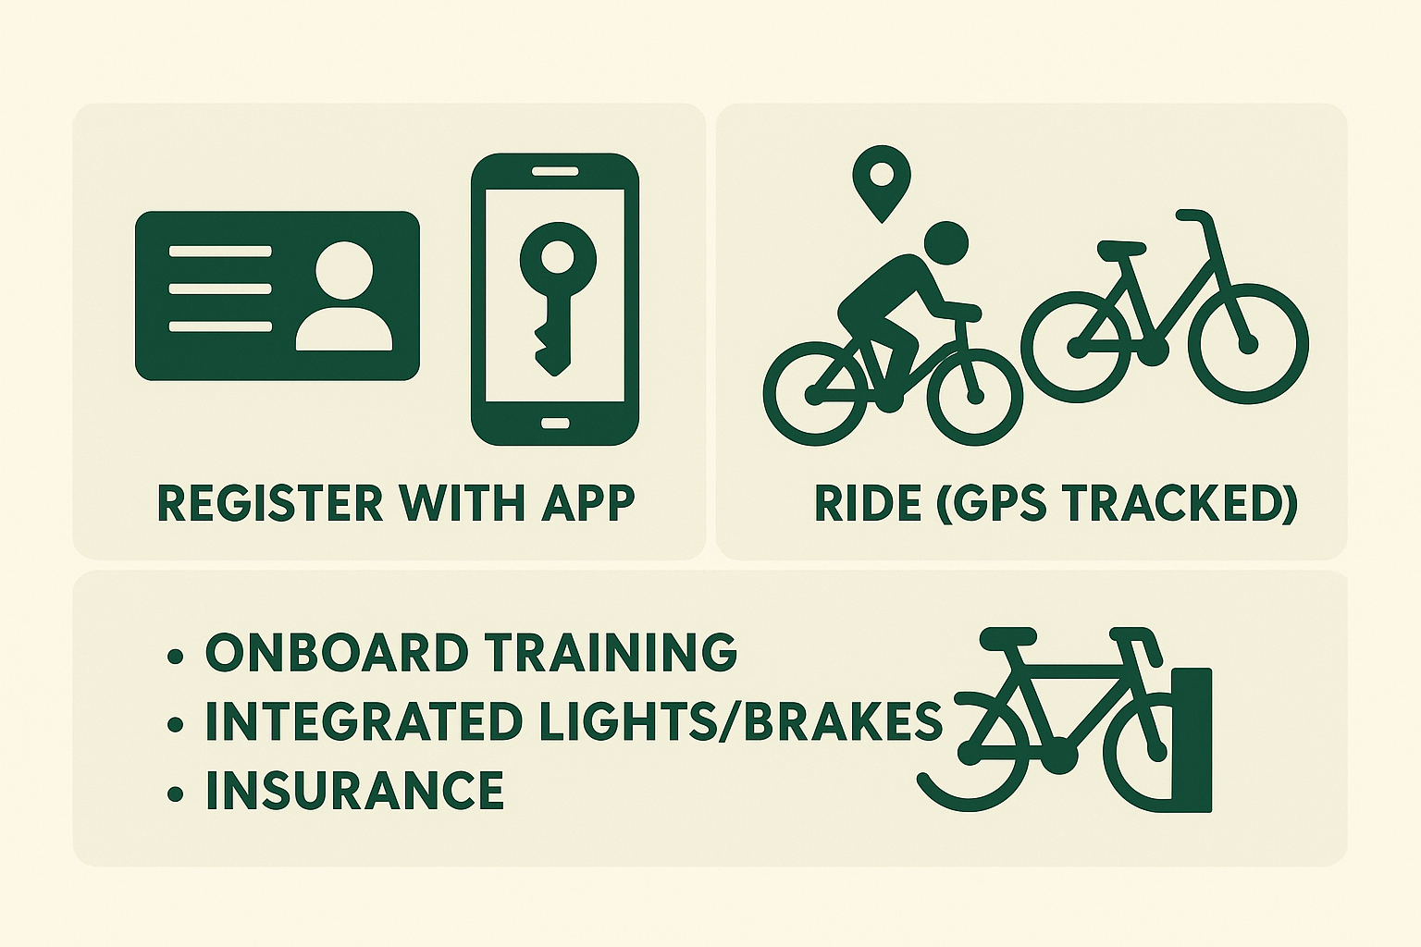
Student User Journey
Register with student ID → Unlock via app → Ride (GPS tracked) → Return to dock.
Safety: onboard training, integrated lights/brakes, insurance.

Slide 7
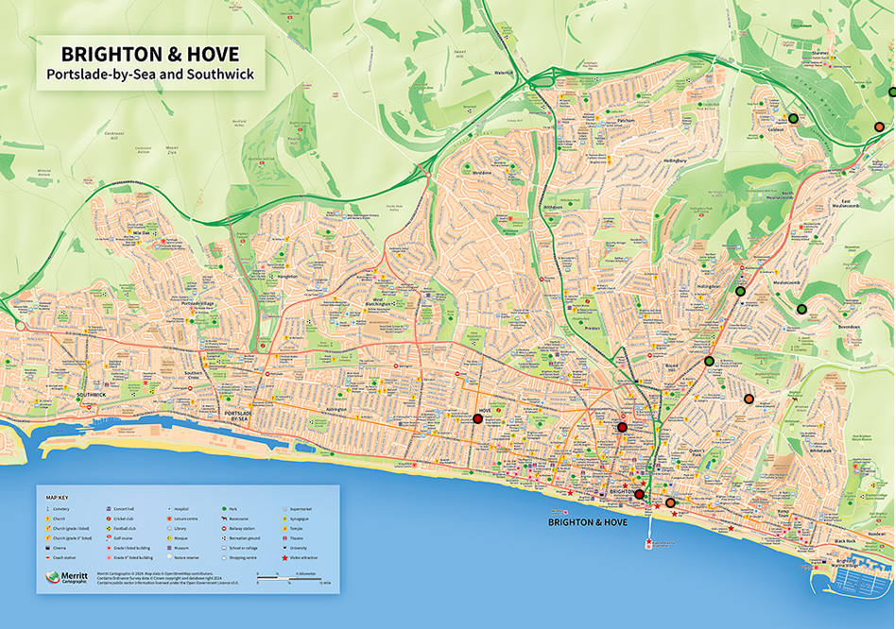
Docking Bay Locations
High Priority: Bevendean, Coldean, Lewes Rd, Moulsecoomb, Stanmer campus.
Medium Priority: Elm Grove, Kemp Town, Stanmer Park.
Low Priority: Old Steine, Brighton Station, Hove.

Slide 8
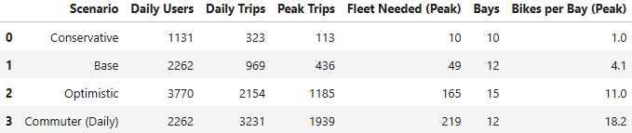
Pricing & Fleet
Pay-per-ride: £1 unlock + £0.06–0.08/min.
Day Pass: £6/day.
Semester Pass: £180–190 (cheaper than bus pass).
Launch promos: first ride free, referral credits, early bonuses.
Fleet: Base case 66 bikes across 12 docks (scales with adoption).

Slide 9
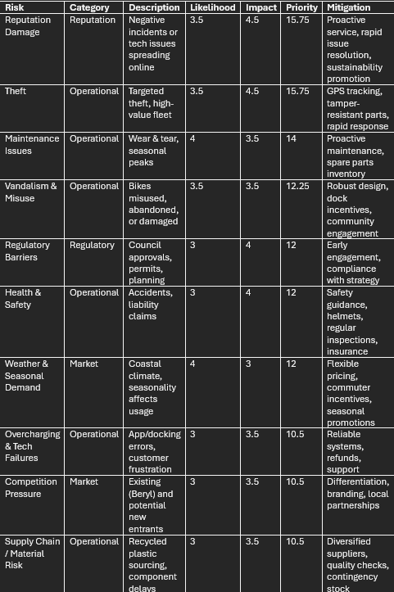
Stakeholders & Risks
Stakeholders: Universities, Council, NHS, local employers.
Risks: theft, vandalism, regulatory delays, weather, low adoption.
Mitigation: GPS tracking, robust design, council alignment, proactive marketing.

Slide 10

Partnerships
Recycling partners: Weez & Merl, Magpie Recycling.
Eco brands: Lucy & Yak, Infinity Foods.
Community groups: Waste House, Earthship Brighton.
Value: sourcing, sponsorship, co-branding, outreach.

Slide 11

Marketing Strategy
Positioning: affordable, sustainable, student identity.
Emotional hooks: “Your bike was once plastic waste”.
Channels: campus activations, social media, PR, referral campaigns.

Slide 12
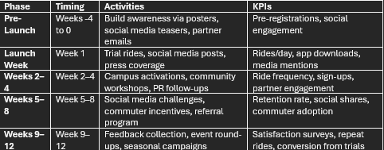
90-Day Launch Plan
Pre-launch (Weeks -4–0): teasers, partner emails, preregistration.
Launch Week: trial rides, PR, campus events.
Weeks 2–4: workshops, promotions.
Weeks 5–8: referral program, challenges.
Weeks 9–12: feedback, seasonal campaigns.

Slide 13
Conclusion
Feasible, student-focused, aligned with city policy.
Combines affordability + sustainability + visibility.
Creates long-term impact while complementing Brighton’s mobility system.

